Slide 1
Programmable logic array(PLA) and MSI based design

Slide 2
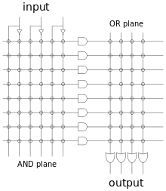
PLA programmable And, programmable OR

Slide 3
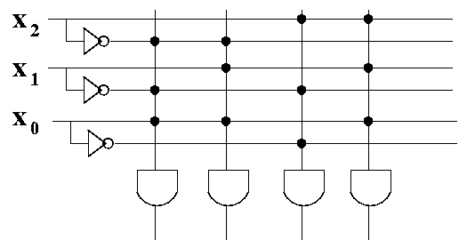
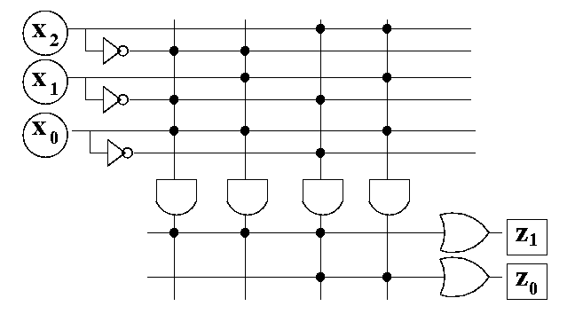
PLA design
x₂ | x₁ | x₀ | z₁ | z₀
0 | 0 | 0 | 0 | 0
0 | 0 | 1 | 1 | 0
0 | 1 | 0 | 0 | 0
0 | 1 | 1 | 1 | 0
1 | 0 | 0 | 1 | 1
1 | 0 | 1 | 0 | 0
1 | 1 | 0 | 0 | 0
1 | 1 | 1 | 0 | 1

Slide 4
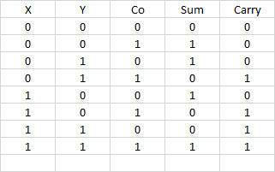

Slide 7
Full adder using 3-8 decoder

Slide 8
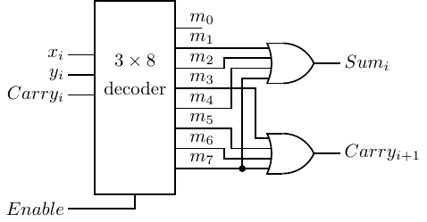
MSI based Design Full adder using 3-8 decoder

Slide 9

Full adder using MUX

Slide 10
Full adder using MUX

